Slide 1
Instructions: In this study, you will view two separate scenarios and then be asked some questions about them. Though the depictions in the materials are suitable for children, we ask that you answer the questions on the basis of what you think and not on the basis of what you think a child might say. Again, we are only interested in what you think.

Slide 2
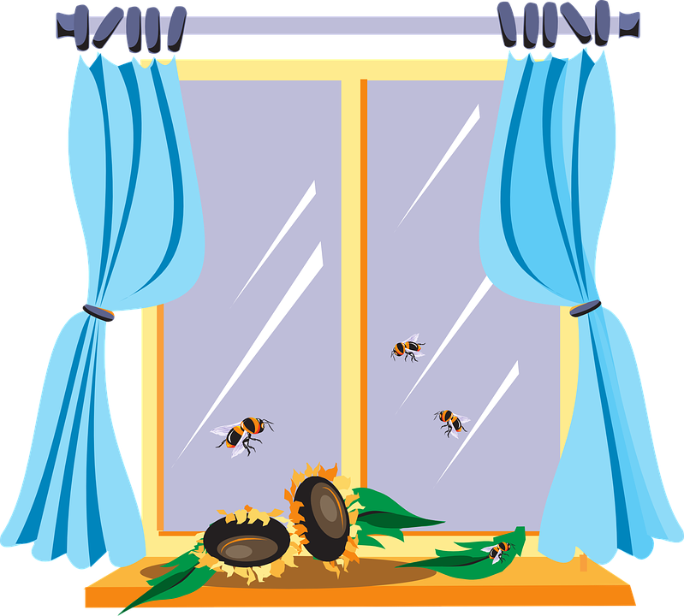
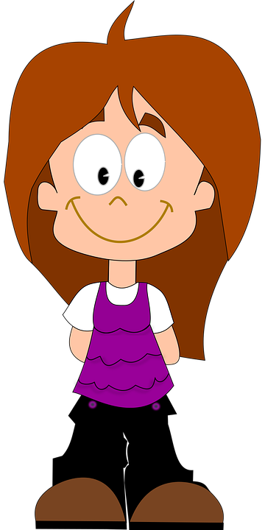

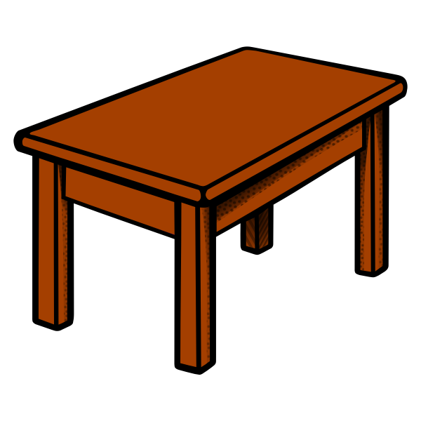


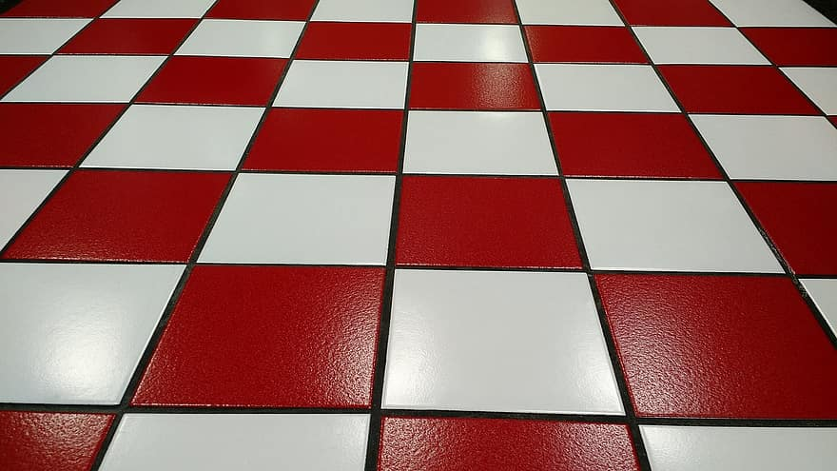
This is Suzy
Notes:
This is Suzy [click]. She is going to go to the beach today. And she has sunscreen [click] and sunglasses [click] to bring with her.

Slide 3
She is going to go to the beach today.
Notes:
This is Suzy [click]. She is going to go to the beach today. And she has sunscreen [click] and sunglasses [click] to bring with her.

Slide 4
And she has sunscreen…
Notes:
This is Suzy [click]. She is going to go to the beach today. And she has sunscreen [click] and sunglasses [click] to bring with her.

Slide 5
and sunglasses to bring with her
Notes:
This is Suzy [click]. She is going to go to the beach today. And she has sunscreen [click] and sunglasses [click] to bring with her.

Slide 6
She puts on her sunglasses
Notes:
She puts on her sunglasses and then she leaves to go to the beach [click]. Oh no she forgot to take her sunscreen! See the sunscreen is still on the table.

Slide 7
And then she leaves to go to the beach
Notes:
She puts on her sunglasses and then she leaves to go to the beach [click]. Oh no she forgot to take her sunscreen! See the sunscreen is still on the table.

Slide 8
Notes:
She puts on her sunglasses and then she leaves to go to the beach [click]. Oh no she forgot to take her sunscreen! See the sunscreen is still on the table.

Slide 9
Notes:
She puts on her sunglasses and then she leaves to go to the beach [click]. Oh no she forgot to take her sunscreen! See the sunscreen is still on the table.

Slide 10
Oh no she forgot to take her sunscreen!
Notes:
She puts on her sunglasses and then she leaves to go to the beach [click]. Oh no she forgot to take her sunscreen! See the sunscreen is still on the table.

Slide 11
See the sunscreen is still on the table
Notes:
She puts on her sunglasses and then she leaves to go to the beach [click]. Oh no she forgot to take her sunscreen! See the sunscreen is still on the table.

Slide 12
To help you remember that Suzy left her sunscreen at home, this picture will stay at the top of your screen.
Notes:
To help you remember that Suzy left her sunscreen at home, this picture will stay at the top of your screen.

Slide 13


Suzy is now at the beach
Notes:
OK Suzy is now at the beach. {click] Do you see that? She is getting a really bad sunburn! Ohhhh, Suzy forgot her sunscreen!

Slide 14

Do you see that? She is getting a really bad sunburn!
Notes:
OK Suzy is now at the beach. {click] Do you see that? She is getting a really bad sunburn! Ohhhh, Suzy forgot her sunscreen!

Slide 15
Ohhh, she forgot her sunscreen!
Notes:
OK Suzy is now at the beach. {click] Do you see that? She is getting a really bad sunburn! Ohhhh, Suzy forgot her sunscreen!

Slide 16
Now that you saw what happened, we will ask you a question
Notes:
OK Suzy is now at the beach. {click] Do you see that? She is getting a really bad sunburn! Ohhhh, Suzy forgot her sunscreen!

Slide 17
Why did Suzy’s skin burn?
Notes:
OK Suzy is now at the beach. {click] Do you see that? She is getting a really bad sunburn! Ohhhh, Suzy forgot her sunscreen!

Slide 18
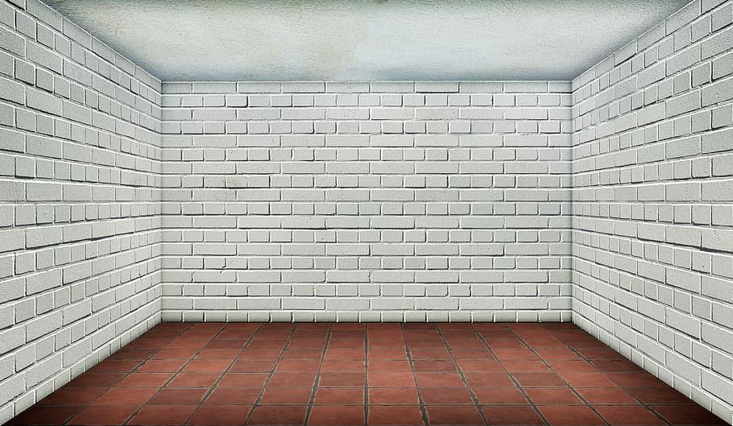

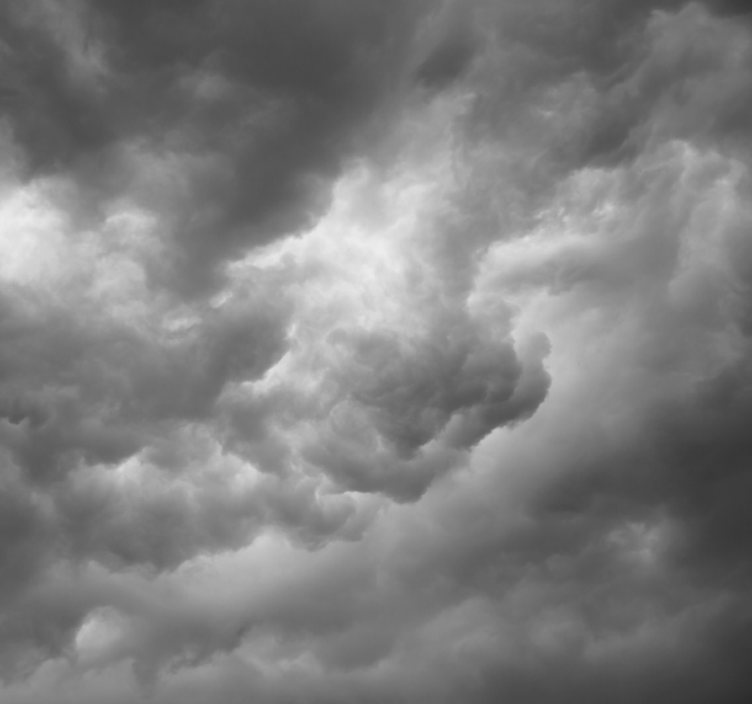
This is Andy
Notes:
This is Andy [click]. And this is Andy’s basement window [click]. See the latch on the window [click]? It is broken! Andy needs to fix the latch on his basement window.

Slide 19
And this is Andy’s basement window
Notes:
This is Andy [click]. And this is Andy’s basement window [click]. See the latch on the window [click]? It is broken! Andy needs to fix the latch on his basement window.

Slide 20
See the latch on the window?
Notes:
This is Andy [click]. And this is Andy’s basement window [click]. See the latch on the window [click]? It is broken! Andy needs to fix the latch on his basement window.

Slide 21
It is broken!
Notes:
This is Andy [click]. And this is Andy’s basement window [click]. See the latch on the window [click]? It is broken! Andy needs to fix the latch on his basement window.

Slide 22
Andy needs to fix the latch on his basement window
Notes:
This is Andy [click]. And this is Andy’s basement window [click]. See the latch on the window [click]? It is broken! Andy needs to fix the latch on his basement window.

Slide 23
Andy takes the latch off the window so he can fix it
Notes:
Andy takes the latch off the window so he can fix it. See Andy is holding the latch [click, then click]?

Slide 24
See Andy is holding the latch
Notes:
Andy takes the latch off the window so he can fix it. See Andy is holding the latch [click, then click]?

Slide 25
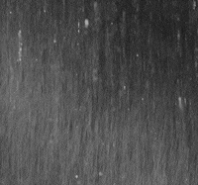

He is now going to fix the latch in his workshop
Notes:
He is going to now go fix the latch in his workshop. But oh no it looks like window is open.

Slide 26
But oh no it looks like the window is open!
Notes:
He is going to now go fix the latch in his workshop. But oh no it looks like window is open.

Slide 27
See window is open!
Notes:
See the window is open!

Slide 28

The window is moving back and forth as Andy goes to his workshop
Notes:
The window is moving back and forth as Andy goes to his workshop

Slide 29



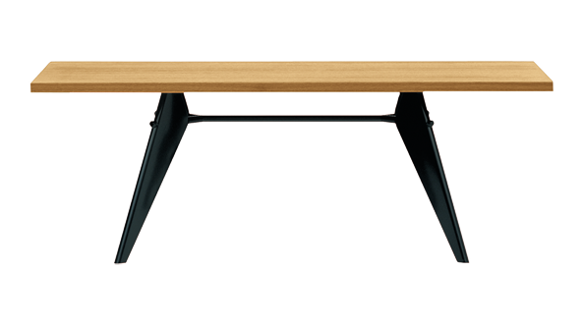
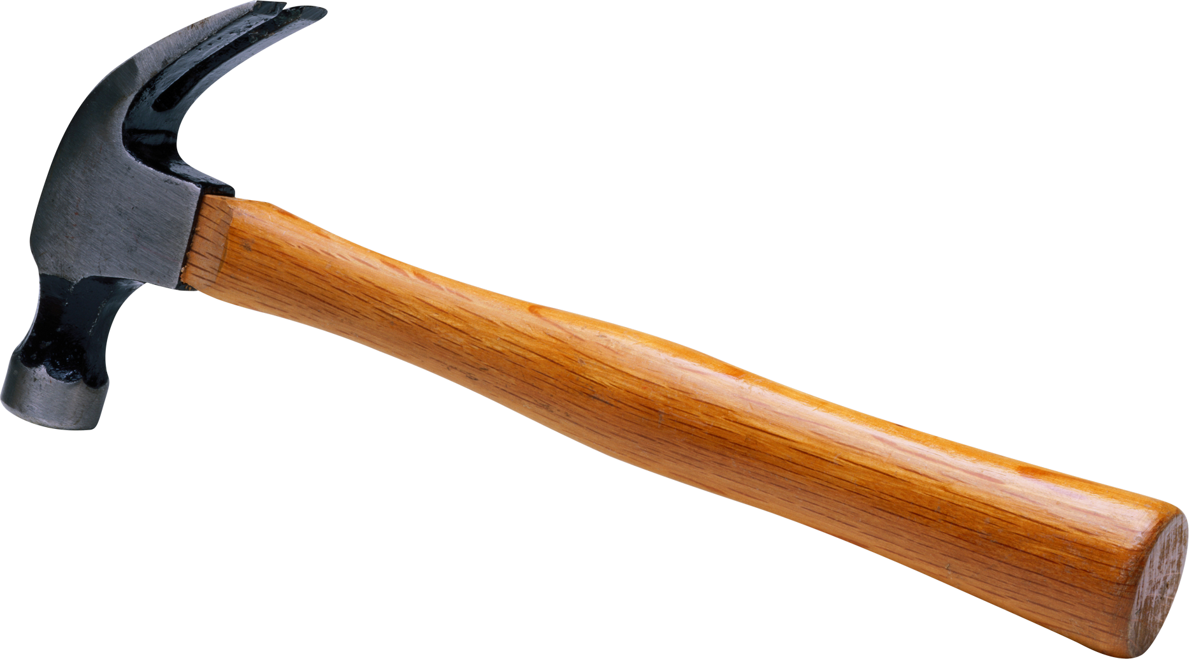
See here is Andy in his workshop with the broken latch
Notes:
See here is Andy in his workshop with the broken latch [click}

Slide 30
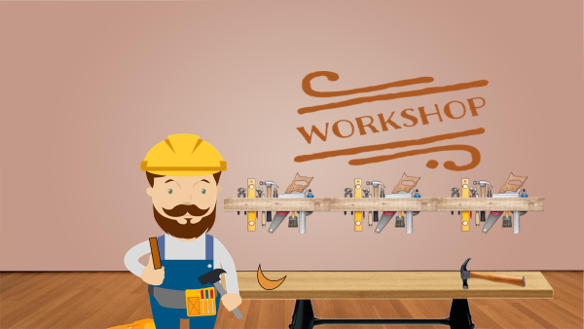
To help you remember that Andy is in his workshop fixing his basement window latch, this picture will remain here on the screen
Notes:
To help you remember that Andy is in his workshop fixing his basement window latch, this picture will remain here on the screen.

Slide 31
As Andy is fixing the basement window latch in his workshop it begins raining really hard.
Notes:
As Andy is fixing the basement window latch in his workshop it begins raining really hard. See the rain?

Slide 32
Look the water is getting really high!
Notes:
Look the water is getting really high. On no the window latch is gone! And the window is open!

Slide 33
Oh no, the window latch is gone!
Notes:
Look the water is getting really high. On no the window latch is gone! And the window is open!

Slide 34
And the window is open!
Notes:
Look the water is getting really high. On no the window latch is gone! And the window is open!

Slide 35
The water is coming in the basement!
Notes:
The water is coming in the basement!

Slide 39
The basement is flooded!
Notes:
The basement is flooded!

Slide 40
Now that you saw what happened, we will ask you a question
Notes:
The basement is flooded!

Slide 41
Why did the basement flood?
Notes:
The basement is flooded!

